Slide 1
Unit IV

Slide 2
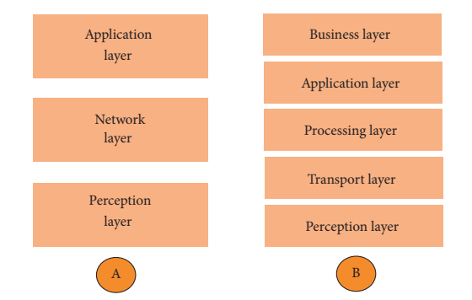
IoT Layered Architecture

Slide 3
Three Layered Architecture
The perception layer is the physical layer, which has sensors for sensing and gathering information about the environment. It senses some physical parameters or identifies other smart objects in the environment.
The network layer is responsible for connecting to other smart things, network devices, and servers. Its features are also used for transmitting and processing sensor data.
The application layer is responsible for delivering application specific services to the user. It defines various applications in which the Internet of Things can be deployed, for example, smart homes, smart cities, and smart health.

Slide 4
Five Layered Architecture
The transport layer transfers the sensor data from the perception layer to the processing layer and vice versa through networks such as wireless, 3G, LAN, Bluetooth, RFID, and NFC.
The processing layer is also known as the middleware layer. It stores, analyses, and processes huge amounts of data that comes from the transport layer. It can manage and provide a diverse set of services to the lower layers. It employs many technologies such as databases, cloud computing, and big data processing modules.
The business layer manages the whole IoT system, including applications, business and profit models, and users’ privacy.

Slide 5
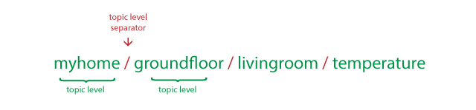
Topics
In MQTT, the word topic refers to an UTF-8 string that the broker uses to filter messages for each connected client. The topic consists of one or more topic levels. Each topic level is separated by a forward slash (topic level separator).
Topics are case-sensitive.

Slide 6
Wildcards
When a client subscribes to a topic, it can subscribe to the exact topic of a published message or it can use wildcards to subscribe to multiple topics simultaneously. A wildcard can only be used to subscribe to topics, not to publish a message.
There are two different kinds of wildcards: single-level and multi-level

Slide 7

Single Level: +
As the name suggests, a single-level wildcard replaces one topic level. The plus symbol represents a single-level wildcard in a topic.

Slide 8

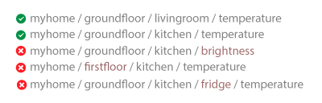

Slide 9
Multi Level: #
The multi-level wildcard covers many topic levels. The hash symbol represents the multi-level wild card in the topic. For the broker to determine which topics match, the multi-level wildcard must be placed as the last character in the topic and preceded by a forward slash.

Slide 10

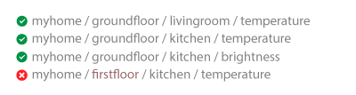

Slide 11
MQTT – How it works
MQTT is a messaging protocol i.e it was designed for transferring messages, and uses a publish and subscribe model.
This model makes it possible to send messages to 0,1 or multiple clients.
In MQTT a publisher publishes messages on a topic and a subscriber must subscribe to that topic to view the message.

Slide 12
Clients do not have addresses like in email systems, and messages are not sent to clients.
Messages are published to a broker on a topic.
The job of an MQTT broker is to filter messages based on topic, and then distribute them to subscribers.
A client can receive these messages by subscribing to that topic on the same broker
There is no direct connection between a publisher and subscriber.
All clients can publish (broadcast) and subscribe (receive).
MQTT brokers do not normally store messages.

Slide 13
MQTT Client-Broker Connections
MQTT uses TCP/IP to connect to the broker.
TCP is a connection orientated protocol with error correction and guarantees that packets are received in order.
Most MQTT clients will connect to the broker and remain connected even if they aren’t sending data.
MQTT clients publish a keepalive message at regular intervals (usually 60 seconds) which tells the broker that the client is still connected.
Connections are acknowledged by the broker using a Connection acknowledgement message.

Slide 14
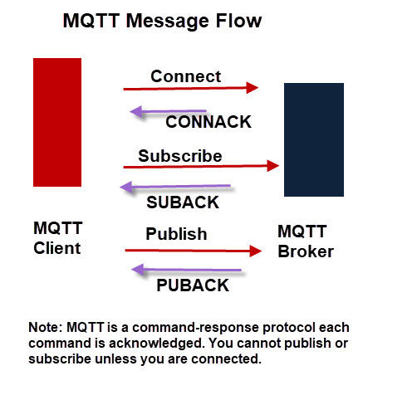
MQTT Message Flow

Slide 15
Client ID
All clients are required to have a client name or ID.
The client name is used by the MQTT broker to track subscriptions etc.
Client names must also be unique.
If you attempt to connect to an MQTT broker with the same name as an existing client then the existing client connection is dropped.
Because most MQTT clients will attempt to reconnect following a disconnect this can result in a loop of disconnect and connect.

Slide 16
Clean Sessions
MQTT clients by default establish a clean session with a broker.
A clean session is one in which the broker isn’t expected to remember anything about the client when it disconnects.
With a non clean session the broker will remember client subscriptions and may hold undelivered messages for the client.
However this depends on the Quality of service used when subscribing to topics, and the quality of service used when publishing to those topics.

Slide 17
Last Will Messages
The idea of the last will message is to notify a subscriber that the publisher is unavailable due to network outage.
The last will message is set by the publishing client, and is set on a per topic basis which means that each topic can have its own last will message.
This means that each topic can have its own last will message associated with it.
The message is stored on the broker and sent to any subscribing client (to that topic) if the connection to the publisher fails.

